Slide 1
Boundary Value Testing
A type of “Black box” functional testing
  The program is viewed as a mathematical “function”
  The program takes inputs and maps some out-puts
  The internal of the program itself is not considered
2. A technique to generate test cases via considering the inputs to the program (sometimes the outputs)
3. The rationale for this focus is that there are experiences from the past which indicate that errors tend to occur at the “extreme” points (especially of inputs).
  Input data
  Loop iteration
  Output fields
Recall this
Is a special
relation

Slide 2
Boundary Value Testing
Two considerations apply to boundary value testing
  are invalid values an issue?
  can we make the “single fault assumption” of reliability theory?
Consequences...
  invalid values require the robust choice
  multiplicity of faults requires worst case testing
Taken together, these yield four variations
  Normal boundary value testing
  Robust boundary value testing
  Worst case boundary value testing
  Robust worst case boundary value testing

Slide 3
A simple example
Consider a program that reads the “age” of students in SWE 3643 and computes the average student-age of the class.
input (s) → Program → output: average age
What type of test data would you input to test this program?

Slide 4
Input (s) to Program Average Example
First question would be - - - how many inputs should we input?
  The answer should be some integer n > 0 , but should be 2 or more?
  (what about 0 input ? --- does that work for “average”)
Second question would be- - - what value should each of the input age be?
  Try some typical age such as 23, 45 or 4
  Try some atypical age 125 or 700
  How about trying a “wrong” age of -5 or 0 or k
When we try the atypical age or some wrong age, we may discover that the program may not “handle” or process properly ---- possibly resulting in a failure or/and incident of failure. (Failure in this case, may include strange answer, but not necessarily program termination.)

Slide 5
Example: Program Average (cont.)
Number of input data, for n > 0.
  We pick the lower bound is n = 1
  How big can n be ? Can n be 1,000,000? (assume, yes)
    Our input test case should include only one input, n = 1
    Our input test case should include n = 1,000,000 inputs
    So 1 and 1000000 are the lower and upper boundaries of the number of inputs, respectively.
    How would the program perform with no data (n=0) or 2,000,500 pieces of inputs?
Age Inputs: composed of only “typical” ages
  Look at the output, average; the value for average is computed either
    Correctly
    Incorrectly
Age Inputs composed of “atypical” or wrong ages
  What is an atypical or wrong age?
    We need/should cap the age from 1 to 150.
    So the lower and upper boundaries for age is 1 and 150, respectively.

Slide 6
Boundaries of the inputs
1 <= number of inputs, n <= 1000000
1
n
1000000
1 <= each age input <= 150
age
150
1
The “basic” boundary value testing would include 5 test cases:
1. - at minimum boundary
2. - immediately above minimum
3. - between minimum and maximum (nominal)
4. - immediately below maximum
5. - at maximum boundary

Slide 7
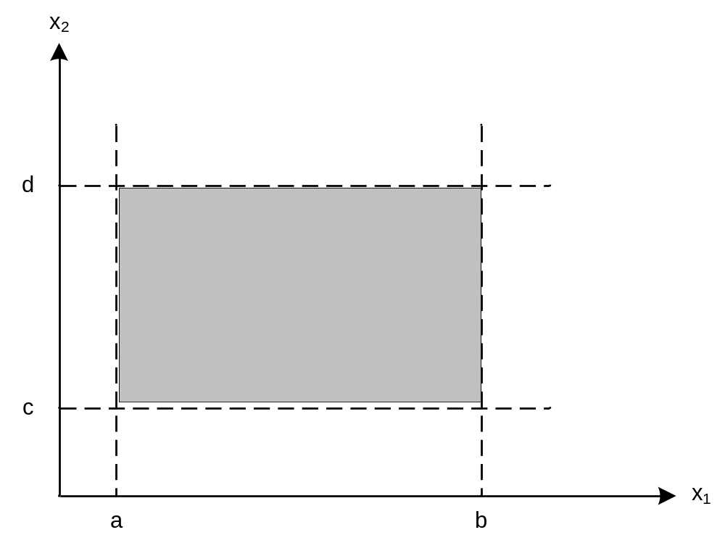
Input Domain of F(x₁, x₂)
where a ≤ x₁ ≤ b and c ≤ x₂ ≤ d

Slide 8
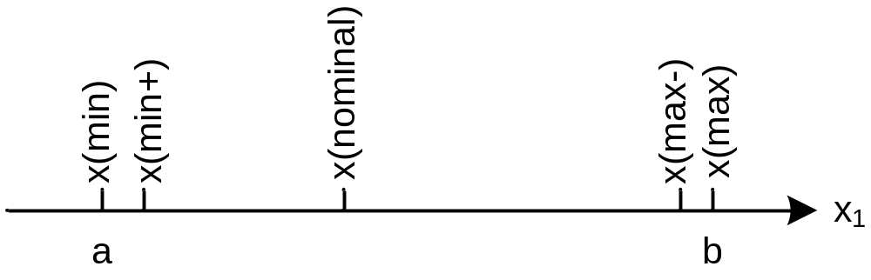
Input Boundary Value Testing
Test values for variable x, where
  a ≤ x₁ ≤ b, and
  x(min), x(min+), ... x(max) are the names from the T tool.

Slide 9
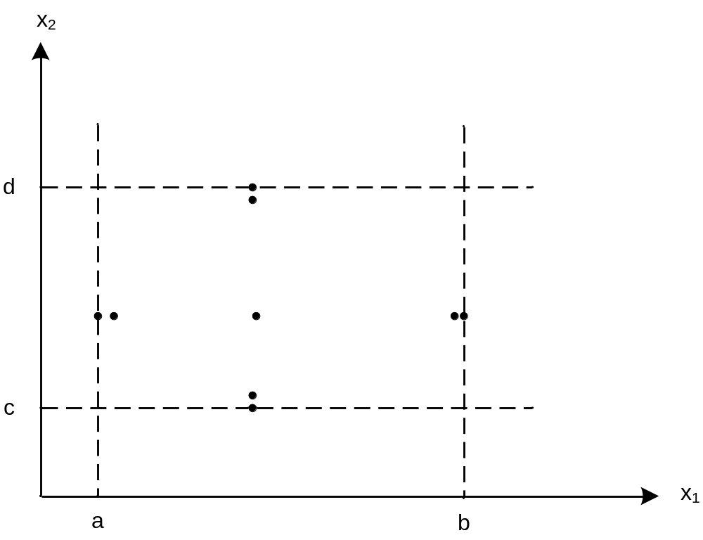
Normal Boundary Value Test Cases
As in reliability theory, two variables rarely both assume their extreme values.

Slide 10
Method
Hold all variables at their nominal values.
Let one variable assume its boundary values.
Repeat this for each variable.
This will (hopefully) reveal all faults that can be attributed to a single variable.

Slide 11
“Single fault” or “independent” faults
For the previous problem, there are 2 “distinct” inputs that are assumed to be independent (single fault) of each other - - - even though there are somewhat related.
  Number of Inputs: n
  Input: age
If they are independent of each other, then we can start with looking at 5 + 5 = 10 sets, but won’t need all 10 of them.
coverage of input data: n
1. n= 1 ; age = whatever
n = 2; age = whatever
3. n = 3; age = whatever
n = 999,999; age = whatever
n = 1,000,000; age = whatever
coverage of input data: age
1. n= 3; age = 1, 20, 105
n =3; age = 2, 20, 67
3. n = 3; age = 3, 20, 55
n = 3; age = 3, 20, 149
n = 3; age = 3, 20, 150

Slide 12
2 – independent inputs
age
This is the n=15 situation
of the previous chart
n
- Note that there needs to be (worst case) only 9 test cases for 2 independent variables or inputs.
- In general, there will be (4z + 1) test cases for z independent inputs.

Slide 13
Program Average example inputs, n and age, are a “little related”
Note that the input, n, and input, age, is a little related in that n dictates the number of input data that is allowed, not just the values that the age input may take on.
For the previous problem we would have to further consider the situation where n = x ; the number of actual input data should be x, so we need to consider:
  - less than x,
  - at x and
  - exceeds x.
  So --- do we need to add more test cases? Recall Boundary Value Test assumed Independent inputs
What do you think ?

Slide 14
Some other “limitations” of Boundary Value Testing
What would we do with Boolean variables?
  True
  False
  We would have to test both true and false cases.
What about non-numerical variable where the values may be text or icons?
  Buttons (same as true/false?)
  Text box (size limits of the text box field ?)
  Text box (strange characters?)
What about the PIN of ATM which ranged from 0000 to 9999? (is boundary value test “meaningful” for security access control testing ?)
What about enumerated type, which may not have a clear boundary?
  Months = {Jan, Feb, - - - -, Dec. } ; do we need to test every value?

Slide 15
Robustness testing
This is just an extension of the Boundary Values to include:
  Less than minimum
  Greater than maximum
There are 7 cases or values to worry about for each independent variable input.
The testing of robustness is really a test of “error” handling.
  Do we anticipate the error situations?
  Do we issue informative error messages?
  Do we allow some kind of recovery from the error?
Tester should
consider how
we handle error
(output side)

Slide 16
A “curve” ball on robustness testing
If we are testing a requirement statement about performance such as the following:
  The system needs to be able to handle 500 simultaneous users.
meaningful/doable?
Test cases to consider for robustness testing:
- assume lower boundary ---- is 0? : test cases of -1; 0; 1 users
- middle can be anything : test case of 350 users
- upper boundary ---- given 500 : test cases of 499; 500; 501
Some people think “robustness” Ξ “stress” and go on to try 600 or 700 simultaneous
users ----- that is NOT what we mean here.

Slide 17
2 – independent inputs for robustness test
X
Y
- Note that there needs to be only 13 test cases for 2 independent variables or inputs.
- In general, there will be (6n+ 1) test cases for n independent inputs.

Slide 18
“Worst-Case” testing for non-independent variables
If the input variables are not independent (or dependent), then we would need to test all possible combinations of values that the variable may take on.
  Worst Case for Boundary Value Testing, each of the 5 possible values of a variable must iterate through the 5 possible values of the other variable(s).
    Thus for n input variables, there are 5^{n} possible test cases
  Worst Case for Robustness Testing, each of the 7 possible values of a variable must iterate through the 7 possible values of the other variable(s).
    Thus for n input variables, there are 7^{n} possible test cases

Slide 19
2 – non-independent (dependent) inputs for worst case test of regular Boundary Values
Y
For 2 dependent
variables, there are
5² = 25 test cases
X
- In general, there will be 5^{n} test cases for n dependent inputs.

Slide 20
Hierarchy
Boundary Value testing of n inputs : 4n + 1
Robustness testing of n inputs : 6n + 1
“Worst case” for boundary value : 5^{n}
“Worst case” for robustness : 7^{n}
1) Boundary Value is a subset of Robustness
2) Worst Case of boundary value is a subset of Worst Case of robustness

Slide 21
Special Value and Random Testing
Special Value Testing:
  Based on past experience
  Based on some special knowledge of the industry
  Ad hoc in nature
  Has had some very valuable inputs and success in finding bugs
  But may be expensive to find the industry “experts”
Random Value Testing;
  Based on some random number generator
  Generate values within bounds of the boundary or worst case
  The value of random test has not been clearly justified

Slide 22
Developing Test Cases for Triangle Problem
Boundary Value Test Cases:
  Input : 3 sides of triangle (thus n = 3 )
    Length of each side is bounded by 1 and 200
      1 <= side 1 <= 200
      1 <= side 2 <= 200
      1 <= side 3 <= 200
  So there are (4n + 1) or [(4 x 3) + 1] = 13 test cases
Worst-case Test cases:
  there should be 5^{n} test cases or 5³ = 125 test cases
Check against
page 80 of
text & reconcile
the difference in
number of test
cases
Note that: --- there needs to be test cases for non-triangles --- are they in here?

Slide 23
NextDate Function
NEXTDATE is a function of three variables: month, day, and
year, for years from 1812 to 2012. It returns the date of the
next day.
NEXTDATE( Dec, 31, 1991) returns Jan 1 1992
NEXTDATE( Feb, 21, 1991) returns Feb 22 1991
NEXTDATE( Feb, 28, 1991) returns Mar 1 1991
NEXTDATE( Feb, 28, 1992) returns Feb 29 1992
Leap Year: Years divisible by 4 except for century years not
divisible by 400. Leap Years include 1992, 1996, 2000.
1900 was not be a leap year.

Slide 24
Boundary Value Test Cases for NextDate
Observations
  not much reason for robustness testing
  good reasons for worst case testing
Large number of test cases
  15 normal boundary value test cases
  125 worst case boundary value test cases
  (see text for test case values)
What problems do you see with the normal boundary value test cases on the next slide?

Slide 25
Boundary Value Test Cases for NextDate
Case | Month | Day | Year | Expected Output
1 | 1 | 1 | 1812 | 1, 2, 1812
2 | 1 | 1 | 1813 | 1, 2, 1813
3 | 1 | 1 | 1912 | 1, 2, 1912
4 | 1 | 1 | 2011 | 1, 2, 2011
5 | 1 | 1 | 2012 | 1, 2, 2012
6 | 1 | 2 | 1812 | 1, 3, 1812
7 | 1 | 2 | 1813 | 1, 3, 1813
8 | 1 | 2 | 1912 | 1, 3, 1912
9 | 1 | 2 | 2011 | 1, 3, 2011
10 | 1 | 2 | 2012 | 1, 3, 2012
11 | 1 | 15 | 1812 | 1, 16, 1812
12 | 1 | 15 | 1813 | 1, 16, 1813
13 | 1 | 15 | 1912 | 1, 16, 1912
14 | 1 | 15 | 2011 | 1, 16, 2011
15 | 1 | 15 | 2012 | 1, 16, 2012

Slide 26
Special Value Test Cases
Case | Month | Day | Year | Reason
SV-1 | 2 | 28 | 2012 | Feb. 28 in a leap year
SV-2 | 2 | 28 | 2013 | Feb. 28 in a common year
SV-3 | 2 | 29 | 2012 | Leap day in a leap year
SV-4 | 2 | 29 | 2000 | Leap day in 2000
SV-5 | 2 | 28 | 1900 | Feb. 28 in 1900
SV-6 | 12 | 31 | 2011 | End of year
SV-7 | 10 | 31 | 2012 | End of 31-day month
SV-8 | 11 | 30 | 2012 | End of 30-day month
SV-9 | 12 | 31 | 2012 | Last day of defined interval

Slide 27
Output Range Test Cases
In the case of the NextDate function, the range
and domain are identical except for one day .
Nothing interesting will be learned from output
range test cases for this example.
Part of the reason for this is that the NextDate
function is a one-to-one mapping from its
domain onto its range. When functions are
not one-to-one, output range test cases are
more useful.

Slide 28
Pros and Cons of Boundary Value Testing
Advantages
  Commercial tool support available
  Easy to do/automate
  Appropriate for calculation-intensive applications with variables that represent physical quantities (e.g., have units, such as meters, degrees, kilograms)
Disadvantages
  Inevitable potential for both gaps and redundancies
  The gaps and redundancies can never be identified (specification-based)
  Does not scale up well (Jorgensen’s Law)
  Tools only generate inputs, user must generate expected outputs.

